Slide 1


User story 1:
Choosing the date
Description: Choose from the three dates.
Estimation: 2 days, 5 hours
Priority: 10
User story 2:
Registration
Description: Clerk to enter the details of the applicant
Estimation: 3 days , 5 hours
Priority: 10
User story 3:
Application status
Description: Accepted, rejected
Estimation: 6 days, 5 hours
Priority: 20
User story 4:
Application Cancellation
Description: cancellation of application.
Estimation: 8 days
Priority: 30
User story 5: Check-in
Description: Check-in of applicant after checking of all documents.
Estimation: 7 days, 5 hours
Priority: 40
User story 6:
Assignment of Bunkhouses
Description : assign bunkhouse to accepted applicants.
Estimation: 9 days
Priority: 20

Slide 2
User story 7:
Assignment of Tribes
Description : assign tribes to accepted applicants.
Estimation: 9 days
Priority: 20
User story 8:
Login
Description : registration clerk(for now).
Estimation: 2 days
Priority: 50

Slide 3
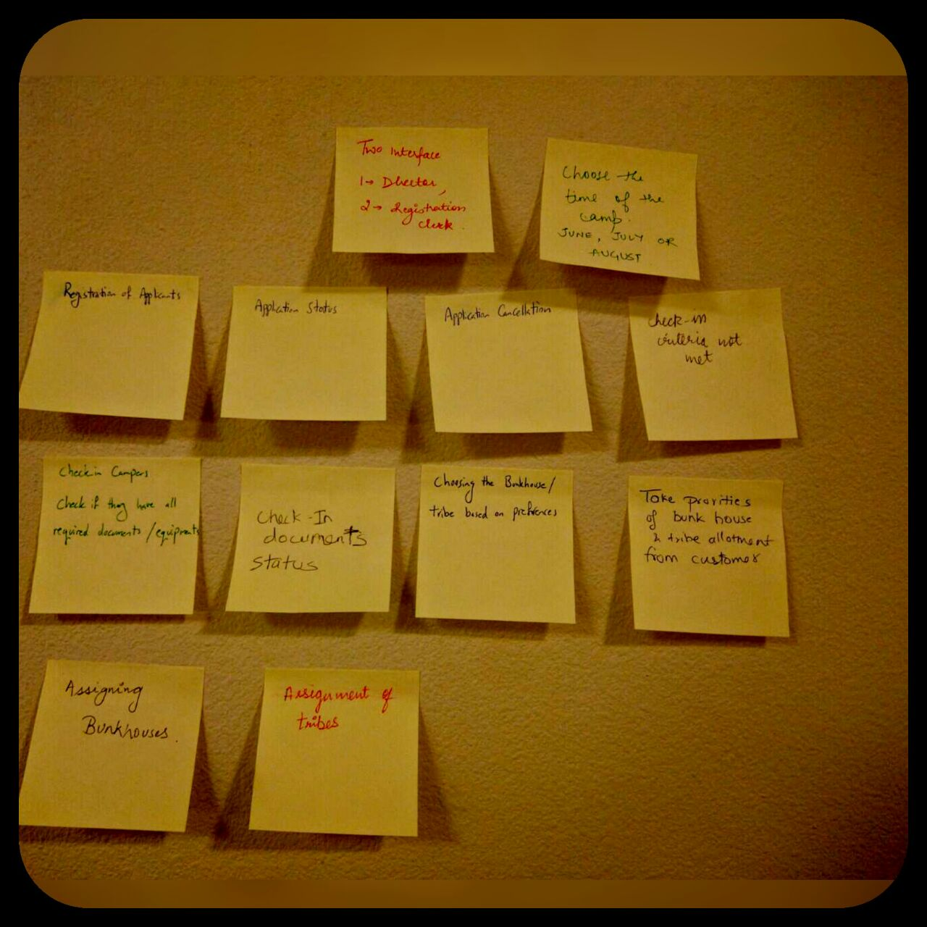

Slide 4
TASK:

Slide 5
